Slide 1
REGRESSION PROJECT ENERGY PREDICTION

Slide 2
PROJECT NAME : P-326
PRECENTED BY :
Miss. LAASYA KAVITI
Miss. VRUNDA
Miss. BINDU
Mr. NAGESH N
Mr. AKUDARI RAKESH

Slide 3
Project Details :
Business Objective:
A combined-cycle power plant comprises gas turbines, steam turbines, and heat recovery steam generators. In this type of plant, the electricity is generated by gas and steam turbines combined in one cycle. Then, it is transferred from one turbine to another. We have to model the energy generated as a function of exhaust vacuum and ambient variables and use that model to improve the plant's performance.
Data Set Details:
This is a project where the variable to be predicted isenergyproduction
The data file contains 9568 observations with five variables collected from a combined cycle power plant over six years when the power plant was set to work with a full load.

Slide 4
PROCESS :
EDA
VISUALIZATION
MODEL BUILDING
MODEL
EVALUATION
DEPLOYMENT
CONCLUSION

Slide 5
EDA:
Exploratory Data Analysis (EDA) is a critical initial step in understanding dataset's characteristics, patterns, and relationships. It involves examining and summarizing the main features of data using various statistical and visualization techniques.
Data Structure: This dataset contains 9568 records and 5 columns. And all columns in float64 data type.
Patterns and Relationship: All featutres are normally distributed. There is no linear relationship in between features except ‘exhaust vaccume’ feature, this feature is 0.84 positively correlating with temparature feature. This feature may not required for model building. Remaining features are normally correlated.
Outlier Detection: For outlier detection we used IsolationForest method and found 1706 values. These values are not good for model building it may reduce model accuracy and model performance.
Statistical summury: Caluclating statistical measure like mean:19,54,1013,73,454; median:20,52,1012,74,451; mode:25,66,1017,84,468; and standard deviation:7,12,5,14,17; all precentails min, max values of the dataset.

Slide 6
Visualization :
Visualization is a powerful tool in data analysis, enabling the representation of complex data in visual formats such as charts, graphs, maps, and more. It plays a crucial role in EDA (Exploratory Data Analysis), communication of findings, and deriving insights from data.
Importing libraries like:
Import matplotli.pyplot as plt : From this library ploting the histogram and box plot for statistical and outlier detection
Import seaborn as sns : using this library for pairplot and relation plots, density plots,correlation matrics,heatmap,etc.

Slide 7
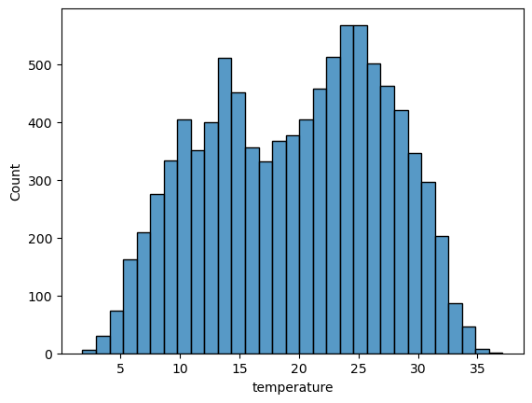
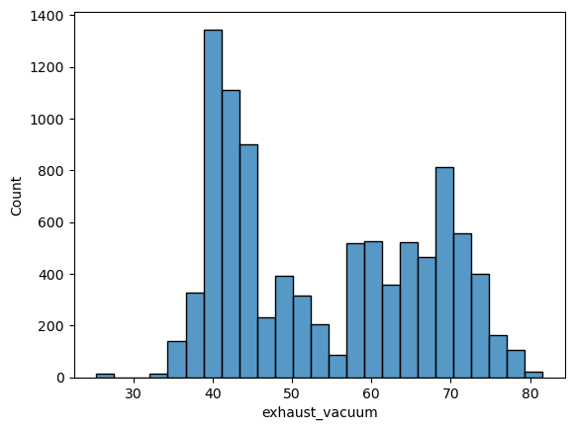
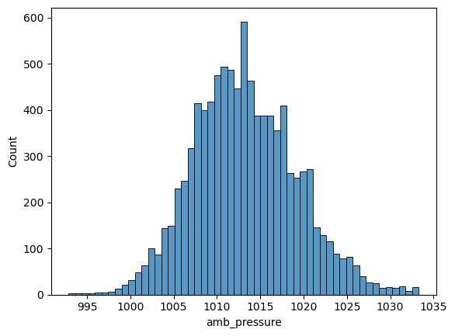
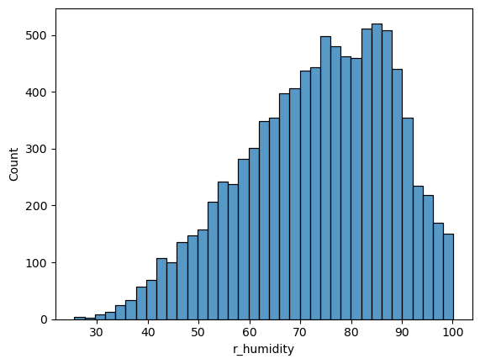
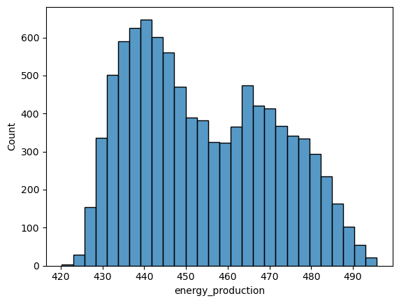
Temperature is more normally distributed
amb_pressure is normally distrubuted
exhaust_energy_Production It has 2 peaks with normally distributed plotvacuum is less normally distributed
r_humidity is left skewed normally distributed

Slide 8
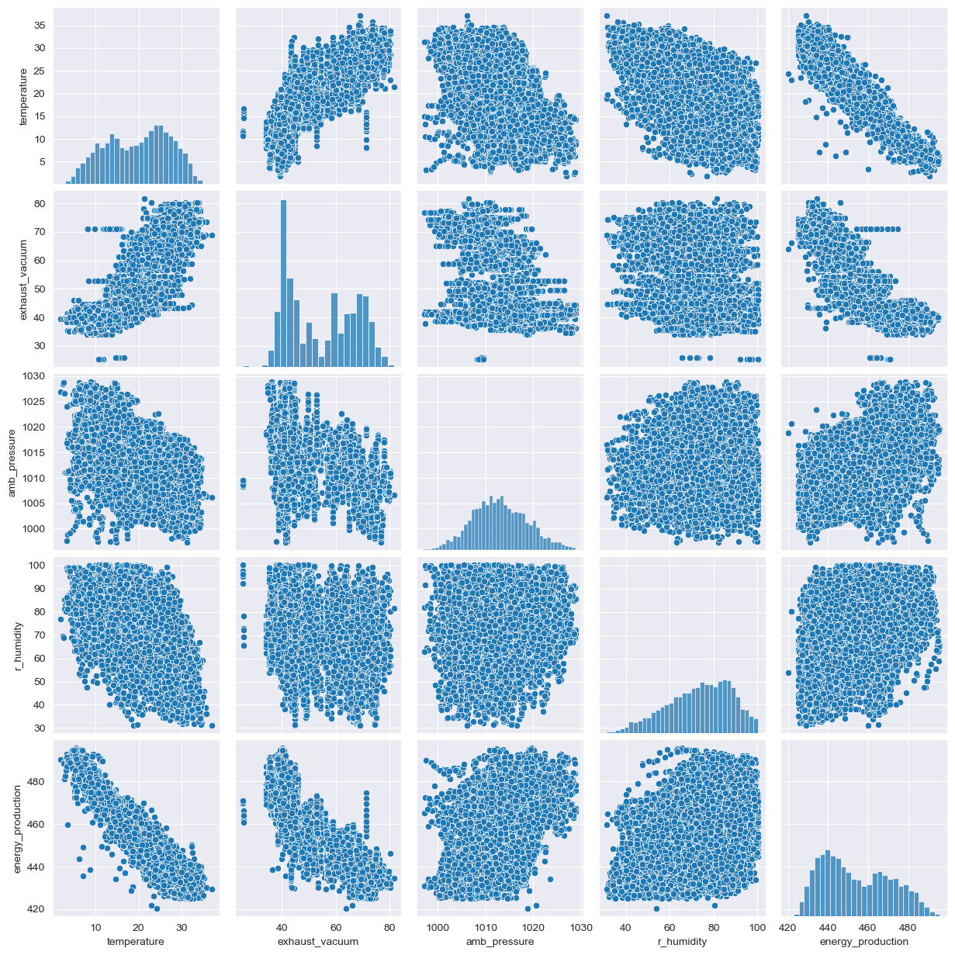

Slide 9
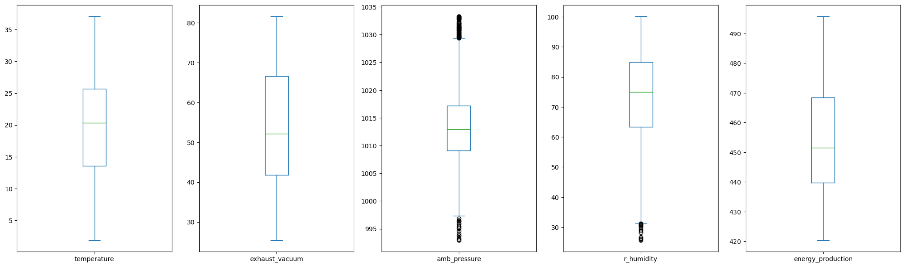
Checking Outlier:
We can checked outliers by using Boxplot
we can say that Ambient Pressure and Relative Humidity has some outliers.

Slide 10
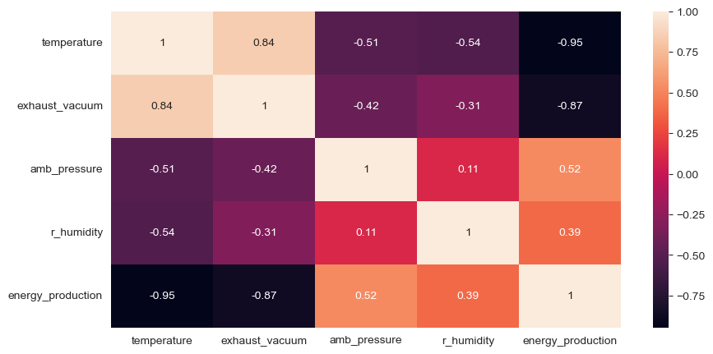
Checking Correlation
-We observed co relation matrix and heatmap, temperature and exhaust_vacuum have strong negative co relation.with the output variable Energy_production
-The amb_pressure and r_humidity weak positive co relationwith output variable energy_production

Slide 11
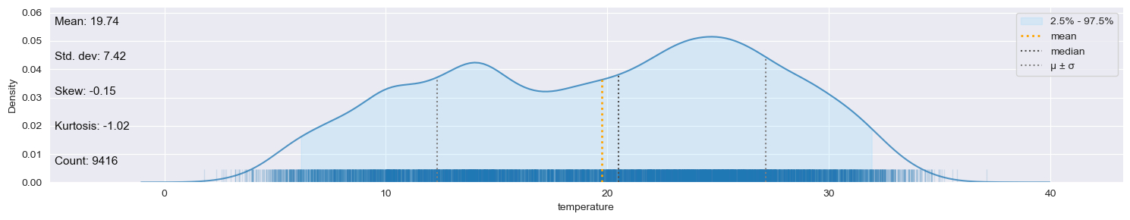
# Checking Missing values using klib
Klib is a great Python library for data analysis and visualization. To check for missing values using klib, you can use the klib.missingval_plot(data_cleaned) function.
# Distribution plot

Slide 12
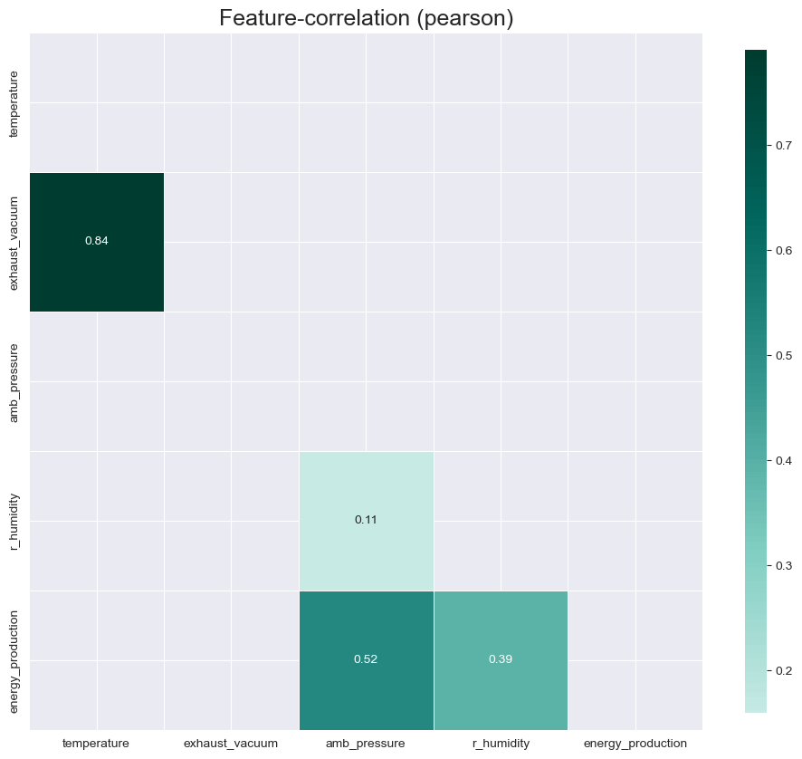
Checking Correlation values using klib
# Checking positive Correlation
Displaying positive correlations. Specify a positive "threshold" to limit the results further.

Slide 13
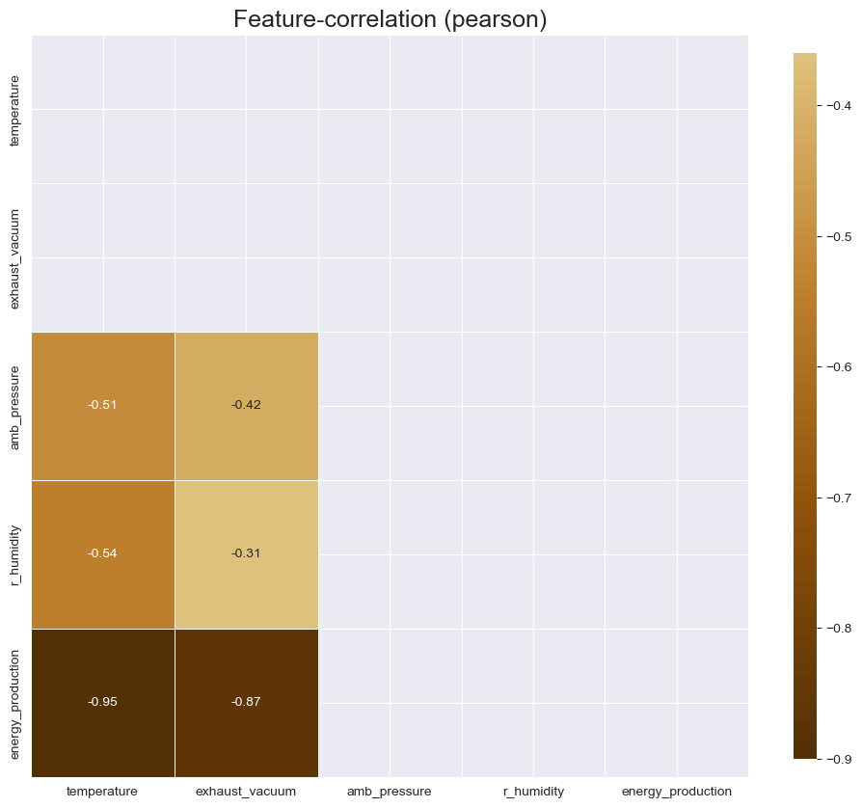
# Checking negative Correlation
Displaying negative correlations. Specify a negative "threshold" to limit the results further.

Slide 14
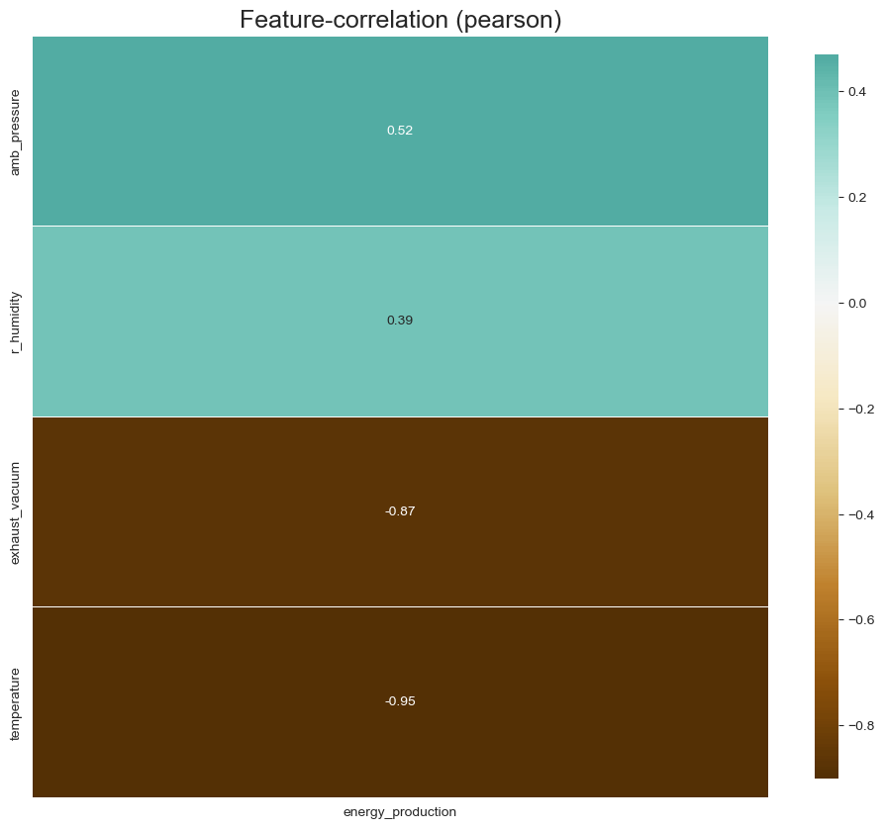
# correlation with a target variable
> we observed co relation plot and heatmap, temperature and exhaust_vacuum have strong negative co relation.with the target variable Energy_production.
>the amb_pressure and r_humidity weak positive co relationwith target variable energy_production.

Slide 15
Feature Engineering:
Preprocessing refers to the steps and techniques applied to raw data before it is used for analysis or machine learning. The goal of preprocessing is to clean, transform, and organize the data in a way that makes it more suitable for the specific task at hand. Here are some common preprocessing steps:
Normalization/Scaling: Scaling numerical features to a standard range (e.g., 0 to 1) to ensure that different features contribute equally to the analysis or machine learning model.
Encoding Categorical Variables: Converting categorical variables into numerical representations, as many machine learning algorithms require numerical input.
Feature Engineering: Creating new features or transforming existing ones to enhance the performance of machine learning models.
Data Splitting: Dividing the dataset into training and testing sets for model evaluation.
Handling Imbalanced Data: Addressing issues when the distribution of classes is uneven in classification problems.
Text Processing: For natural language processing tasks, preprocessing might involve tokenization, stemming, or lemmatization.

Slide 16
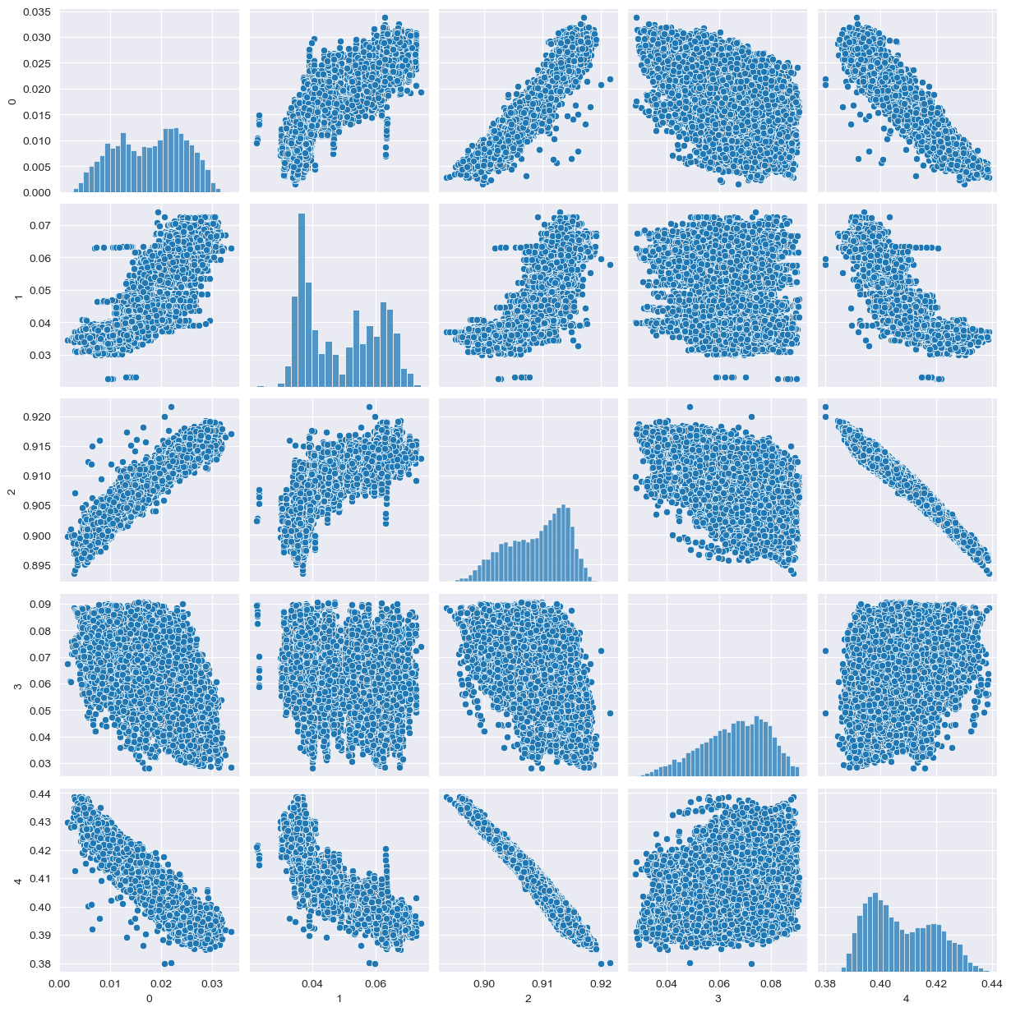

Slide 17
Train-Test-split :
The train_test_split function from the sklearn.model_selection module in scikit-learn is a handy utility for splitting a dataset into training and testing sets. This is a crucial step in machine learning model development to evaluate the model's performance on unseen data.

Slide 18
Random Forest
KNN
Gradient Boosting
Model Building
Bagging meta Estimator
Adaboost

Slide 19
Random Forest Regressor is an ensemble learning technique that uses multiple decision trees to make predictions for regression tasks. It's an extension of the Random Forest algorithm, which is widely used for both classification and regression problems.
Random Forest Regressor builds multiple decision trees (the "forest") by sampling the dataset with replacement (bootstrapping) and using random subsets of features for each tree.
Each decision tree is trained independently on these subsets of the data, resulting in a collection of diverse trees.
For regression tasks, when making predictions, the algorithm aggregates the predictions of all individual trees to derive the final output.
In the case of Random Forest Regression, the final prediction is the average (or weighted average) of predictions made by individual trees.
RANDOM FOREST regression model
MAE: 0.00022899602606753116
MSE: 1.1006618864515853e-07 RMSE: 0.00033176224716679044
R-squared : 99.92

Slide 20
K-Nearest Neighbors (KNN) is a simple yet powerful machine learning algorithm used for both classification and regression tasks. It's an instance-based, non-parametric learning algorithm that's easy to understand and implement.
Given a new data point, the algorithm finds the K nearest neighbors.
Regression: For regression tasks, KNN computes the average (or weighted average) of the target values of these K neighbors and assigns it as the predicted value for the new data point.
K-Value Selection: The number of neighbors (K) is a hyperparameter in KNN. Choosing the right K value is crucial; smaller K values lead to more flexible models (prone to noise), while larger K values can oversmooth the decision boundary.
Distance Metrics: Common distance metrics used in KNN include Euclidean distance, Manhattan distance, Minkowski distance, etc. The choice of distance metric influences the model's performance.
KNN Model :
MAE: 0.0008403014729268706
MSE: 1.3710731751300588e-06
RMSE: 0.0011709283390242372
R-squared : 99.03

Slide 21
Bagging (Bootstrap Aggregating) is a machine learning ensemble technique that involves training multiple instances of a base model on different subsets of the training data and combining their predictions. The Bagging meta-estimator aims to reduce overfitting and variance, often leading to improved model performance.
Bootstrap Sampling: Multiple subsets of the training data are created by random sampling with replacement (bootstrap sampling). Each subset is used to train a separate instance of the base model.
Base Model Training: The base model (which could be any machine learning algorithm) is trained on each subset independently.
Aggregation: The predictions of each individual model are combined to make a final prediction. For regression problems, this may involve averaging the predictions, while for classification problems, it could involve voting.
The key idea behind Bagging is that by training multiple models on different subsets of data and combining their predictions, the ensemble model tends to have lower variance and better generalization performance than any individual model.
Bagging meta Estimator
MAE: 0.00023034388120423527
MSE: 1.0828486637566537e-07
RMSE: 0.00032906665947139853
R-squared : 99.923

Slide 22
AdaBoost, short for Adaptive Boosting, is another ensemble learning method that aims to improve the performance of weak learners (models that are only slightly better than random guessing) by combining them into a strong learner. AdaBoost assigns different weights to training instances and adjusts these weights iteratively based on the performance of the weak learners.
Initialization: Each instance in the training set is initially assigned an equal weight.
Weak Learner Training: A weak learner (often a decision tree with limited depth) is trained on the weighted training data.
Weight Update: The weights of the training instances are adjusted based on the performance of the weak learner. Instances that are misclassified are given higher weights, while correctly classified instances are given lower weights.
Model Combination: The weak learner's prediction is combined with the predictions of previous weak learners, each weighted according to its performance.
Iteration: Steps 2-4 are repeated for a specified number of iterations or until a perfect model is achieved.
Adaboost
MAE: 0.0012948562960728848
MSE: 2.5632141712450358e-06
RMSE: 0.0016010041134378874
R-squared : 98.19

Slide 23
Gradient Boosting is an ensemble learning method that builds a series of weak learners (typically decision trees) sequentially, where each new tree corrects the errors made by the previous ones. The core idea behind Gradient Boosting is to fit each new tree to the residuals (the differences between the actual and predicted values) of the combined ensemble.
Initialization: The model starts with an initial prediction, often the mean of the target variable for regression problems or a class probability for classification problems.
Building Trees: A weak learner (usually a shallow decision tree) is trained to predict the residuals of the current ensemble. This new tree is added to the ensemble with a weight that is determined by a learning rate parameter.
Updating Predictions: The predictions of the ensemble are updated by adding the predictions of the newly trained tree, scaled by the learning rate.
Iteration: Steps 2 and 3 are repeated for a specified number of iterations or until a certain level of performance is reached.
Gradient Boosting
MAE: 0.0003008876550616457
MSE: 1.5197810110935966e-07
RMSE: 0.0003898436880460676
R-squared : 98.19

Slide 24
Model evaluation is an iterative process that helps in model's performance and generalization capabilities on unseen data. understanding a model's strengths, weaknesses, and its suitability for the problem at hand. It plays a crucial role in developing robust and reliable machine learning models.
from sklearn library importing Mean Squared Error (MSE), Root Mean Squared Error (RMSE), Mean Absolute Error (MAE), R-squared (Coefficient of Determination).
Model evalution :
0 | Model Bagging | RMSE 0.000329
1 | Random Forest | 0.000332
2 | GBM | 0.000390
3 | KNN | 0.001171
4 | Adaboost | 0.001601

Slide 25
Deployment :
Deployment is final process of the work, to create a web app by using the stramlit library.
In this we created user data frame with user input values that are related to original dataset values.
For this deployment I created a pickle .sav file for the model building and for the model prediction.we predicting the user input data with this pickle file.
For deployment using the random forest model, this model predict the unseen data with accuracy of 96%.
In web app created a submit button, if the user click on the submmit button it predict the energy production out put.

Slide 26
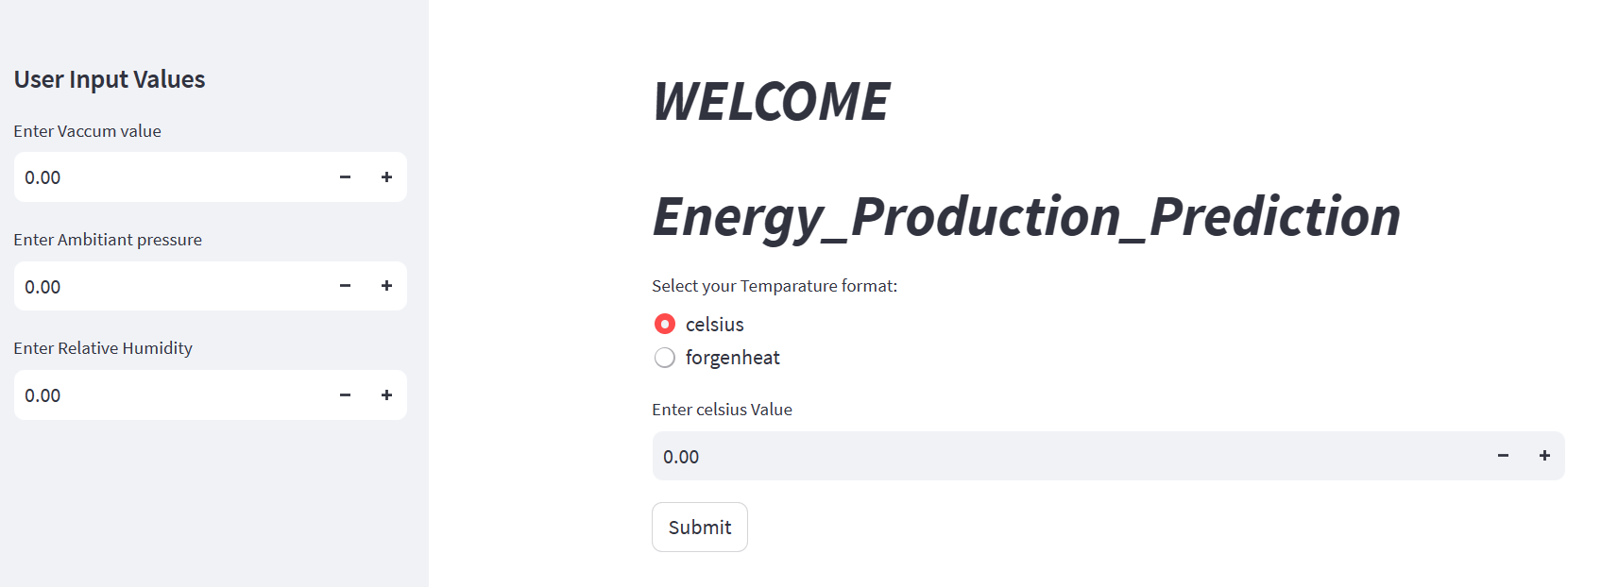

Slide 27
Conclusion :
This dataset contains 5 columns, and 9568 rows all non null values.
Train this dataset with different regression models, from this find scores and performance of the models.
After comparing all scores and performance of the models, finalaize Bagging meta Estimator model is the best for our dataset.
The Bagging meta Estimator model is giving the best accuracy score is 99.923% and it performing well on test data and giving good predictions on test data.
And it improving the model strength by reducing the mean square error. It reducing the errors in between test data and predictions.
Finalizing model is Bagging meta Estimator with n_estimators = 300.

Slide 28
THANK-YOU

